Slide 1
Computer Vision

Slide 2
Tools
OpenCV
Pillow
Scikit-Image

Slide 3
OpenCV
Demo

Slide 4
Domains
Object Detection
Object Segmentation
OCR

Slide 5
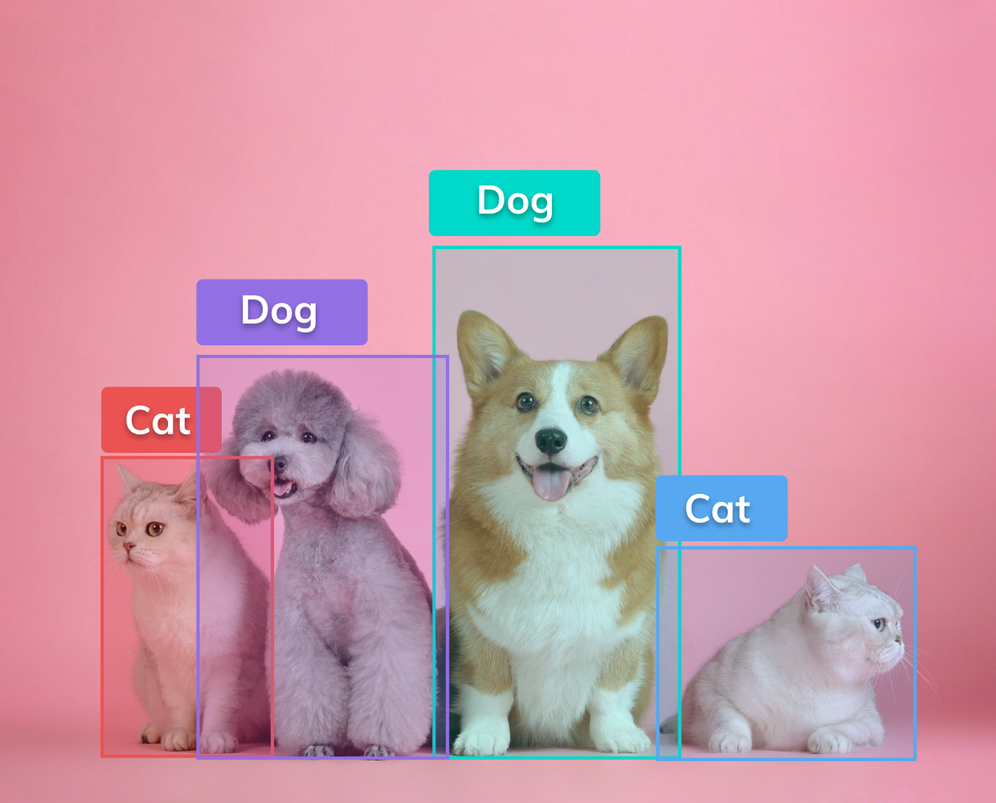
Object Detection

Slide 6
Demo

Slide 7
Popular Object Detection Model
RCNN
Fast-RCNN
YOLO

Slide 8
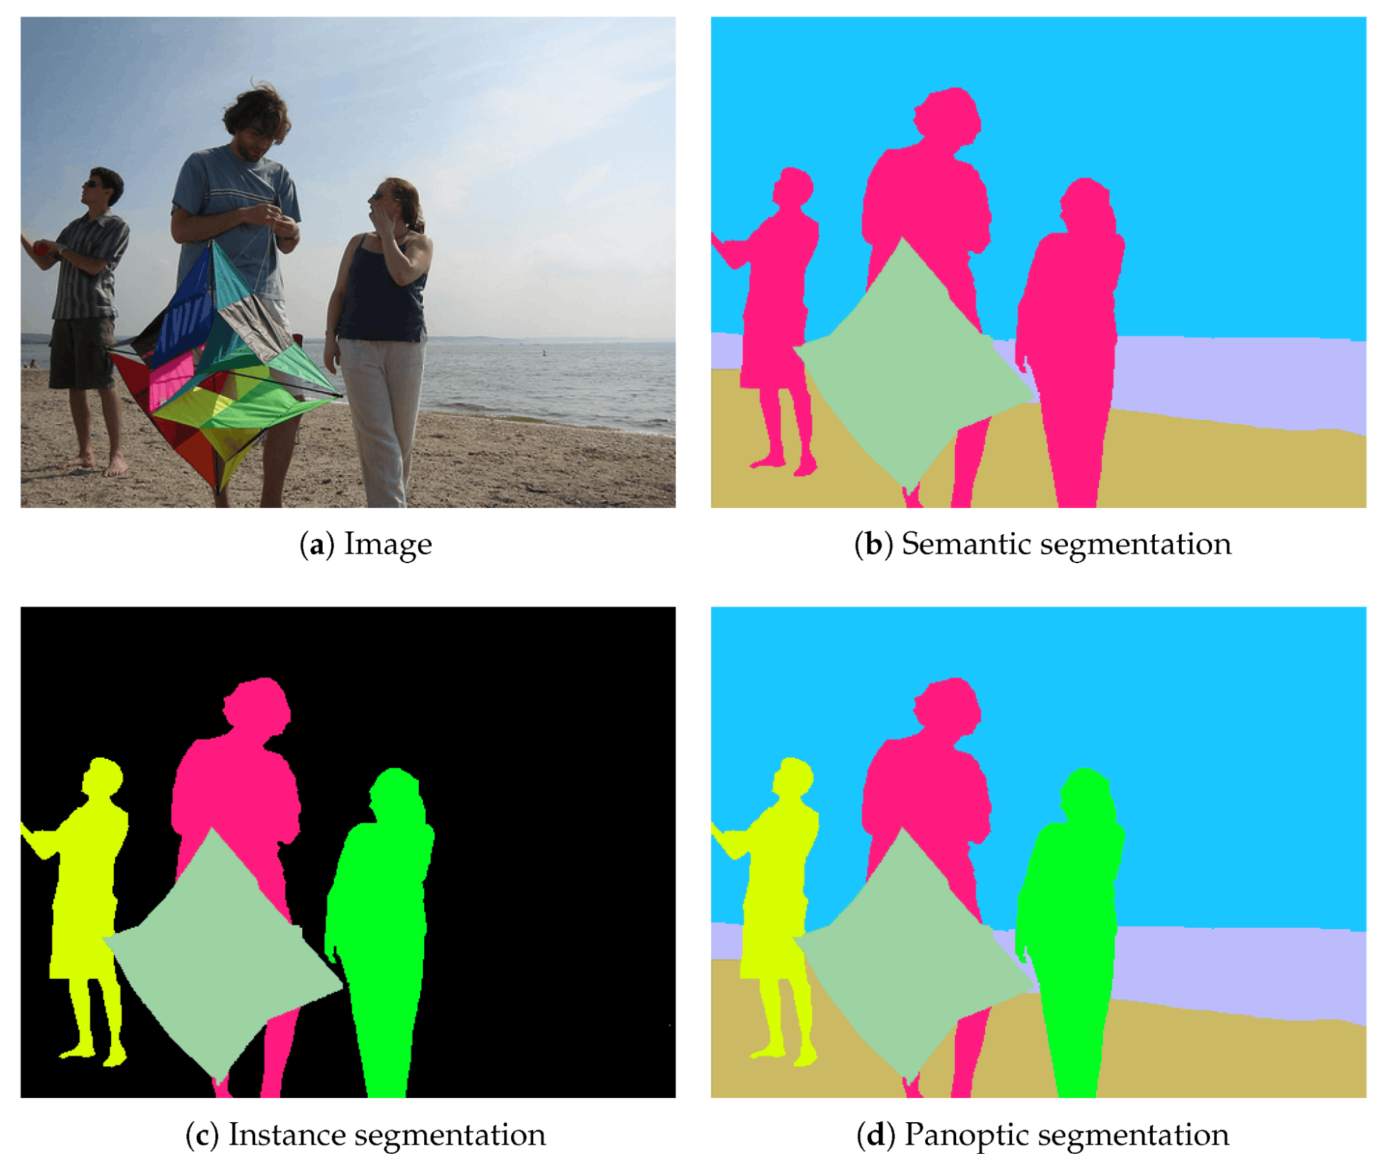
Object Segmentation

Slide 9
Popular Method
Unet

Slide 10
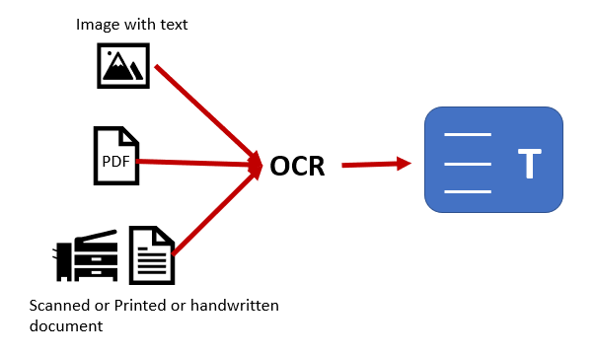
OCR

Slide 11
Demo

